Slide 1

A Comparative Study of Machine Learning Algorithms for Flight Delay Prediction
Aman Jawalekar
22070243022
MSc Data Science and Spatial Analytics Symbiosis Institute of Geoinformatics, Pune, Maharashtra

Slide 2
Problem Statement
The aviation industry faces the ongoing challenge of flight delays, which result in inconveniences for passengers, operational difficulties for airlines and airports, financial losses, missed connections, and reduced customer satisfaction. The traditional methods for managing flight delays, relying on statistical analysis and rule-based systems, have struggled to address the complex and dynamic nature of flight data, leading to suboptimal delay management strategies.

Slide 3
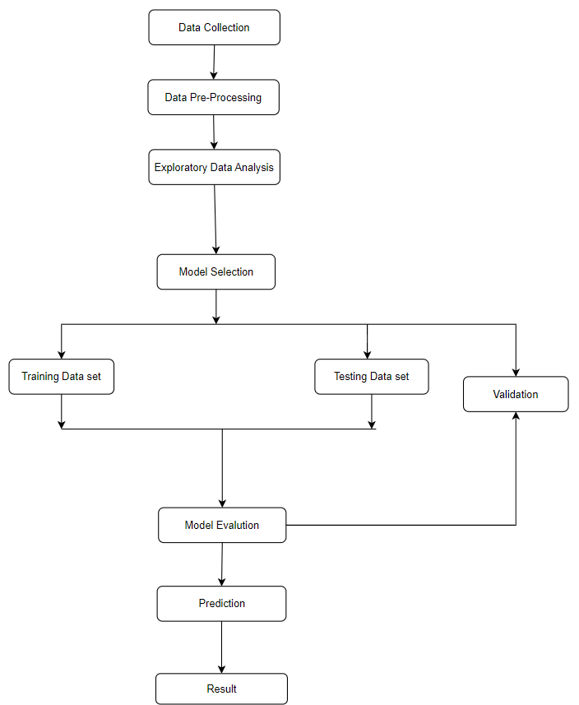
Methodology

Slide 4
Data Collection
The U.S. Department of Transportation's (DOT) Bureau of Transportation Statistics tracks the on-time performance of domestic flights operated by large air carriers. Summary information on the number of on-time, delayed, canceled, and diverted flights is published in DOT's monthly Air Travel Consumer Report and in this dataset of 2015 flight delays and cancellations.
The flight delay and cancellation data was collected and published by the DOT's Bureau of Transportation Statistics and is available from Kaggle
Dataset – https://www.kaggle.com/datasets/usdot/flight-delays)

Slide 5
Data Pre-Processing
Handling missing values by dropping rows with missing data.
Dropping unnecessary columns from the dataframe.
Adding new column called Delay.

Slide 6
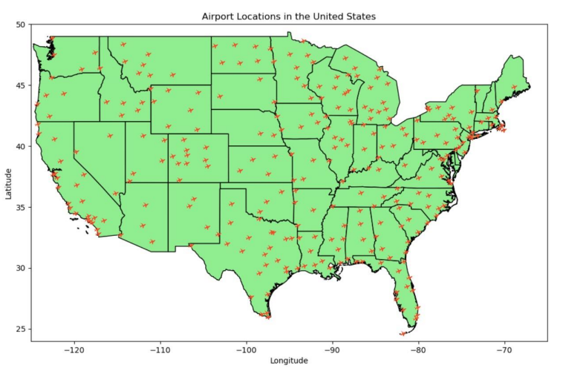
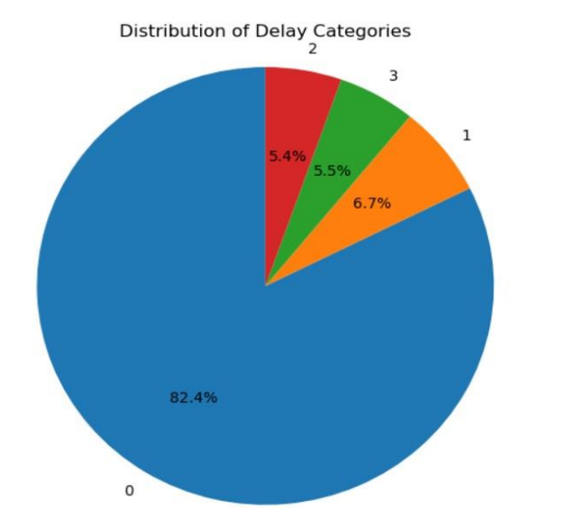
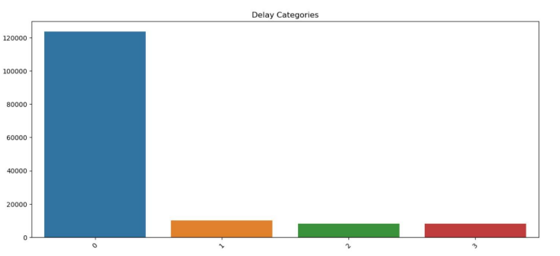
Exploratory Data Analysis

Slide 7
Model Selection:
Decision Tree Algorithm:Decision trees are a machine learning algorithm that can be used to classify or regress data. They work by partitioning the data based on features, making decisions at each node. Decision trees are popular because they are simple and interpretable, and can handle both categorical and numerical data.
Random Forest Algorithm:Random Forest is an ensemble learning algorithm that builds multiple decision trees to make predictions. It is robust to noisy data and can handle missing values well.
Support Vector Machine:SVM is a supervised learning algorithm that finds the optimal line or hyperplane to separate data into classes. It works well with high-dimensional data and can handle non-linearly separable data.
Logistic Regression Algorithm:Logistic regression is a statistical model that predicts the probability of a binary outcome, such as yes or no. It is a simple and interpretable model that can be used to handle both categorical and numerical features. Logistic regression can be extended to handle multi-class classification problems as well.
Training set & Testing set:
The data is divided into a 70% training set and a 30% test set. The training set is used to design and train a classifier, while the test set is reserved to evaluate the classifier's performance. Before training, the feature variables are standardized using StandardScaler. Once the classifier is trained, it can make predictions on the test set to assess its accuracy and effectiveness. This approach ensures that the classifier learns from a substantial portion of the data and can generalize well to unseen instances.

Slide 8
Decision Tree:
The Decision Tree model is a type of supervised learning algorithm that is used for classification and regression tasks.
It creates a tree-like model where each internal node represents a feature, each branch represents a decision rule, and each leaf node represents the outcome or class label.
In our analysis, we used the Decision Tree Classifier to predict flight delay categories based on various features such as scheduled arrival time, departure delay, etc.
The model achieved an accuracy score of 0.840, indicating its effectiveness in predicting flight delays.

Slide 9
Random Forest Classifier:
The Random Forest Classifier is an ensemble learning method that combines multiple decision trees to make predictions.
It creates a collection of decision trees, where each tree makes a prediction, and the final prediction is determined by voting or averaging the predictions of all trees.
In our analysis, we used the Random Forest Classifier to predict flight delay categories.
The model achieved an accuracy score of 0.827, demonstrating its ability to effectively predict flight delays.

Slide 10
Support Vector Machine (SVM):
Support Vector Machine is a powerful supervised learning algorithm used for classification and regression tasks.
It finds the optimal hyperplane in a high-dimensional feature space that maximally separates different classes.
In our analysis, we used the SVM Classifier to predict flight delay categories.
The model achieved an accuracy score of 0.792, indicating its capability to classify flight

Slide 11
Logistic Regression:
Logistic Regression is a popular statistical model used for binary classification problems.
It estimates the probability of the outcome by fitting a logistic function to the input features.
In our analysis, we used Logistic Regression to predict flight delay categories.
The model achieved an accuracy score of 0.727, showcasing its effectiveness in classifying flight delays.

Slide 12
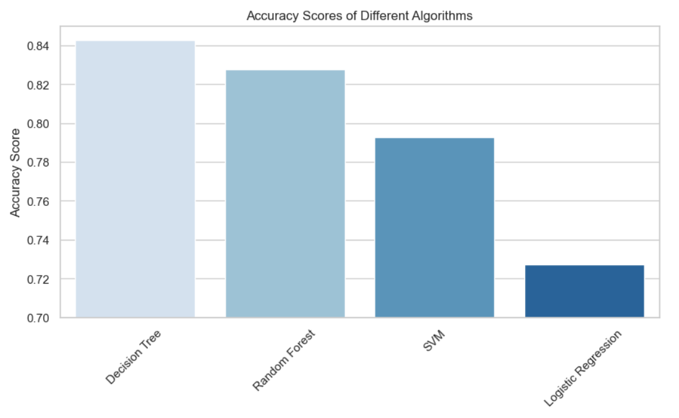
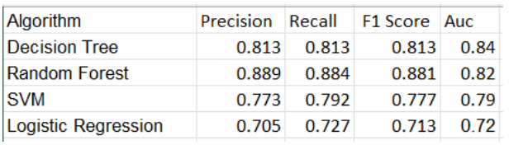
Model Evalution
Decision Tree: The model's accuracy is given as 0.840.
Random Forest Classifier: : The model's accuracy is given as 0.827
SVM: : The model's accuracy is given as 0.792
Logistic Regression: The model's accuracy is given as 0.727

Slide 13
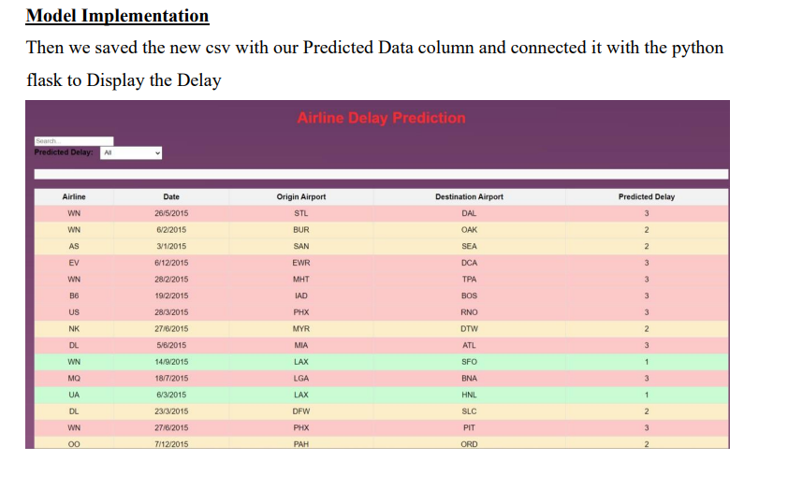
Conclusion:
Tools used for Model Implementation: Pycharm for Python Flask & Html for Webpage
The analysis provides valuable insights into the factors contributing to delays in the airline industry, enabling airline companies to understand and address them.
Airline companies can utilize this information to develop effective strategies for improving their on-time performance.
Specific areas that need improvement, such as weather conditions, air system issues, and airline-related factors, can be identified and targeted.
Researchers can enhance their analytical skills, generate fresh research ideas, and make meaningful contributions to their respective fields by adopting the techniques and methodologies presented in this project.
This project serves as a solid foundation for further research, encouraging researchers to explore and address pertinent issues related to flight delays and airline operations.
In conclusion, this analysis offers valuable resources to both airline companies and researchers, facilitating operational efficiency improvements and enriching the knowledge base of the industry.

Slide 14
Thank You

